Slide 1
Predicting NBA’s MVPs
Leong Keng Whye
30 May 19

Slide 2
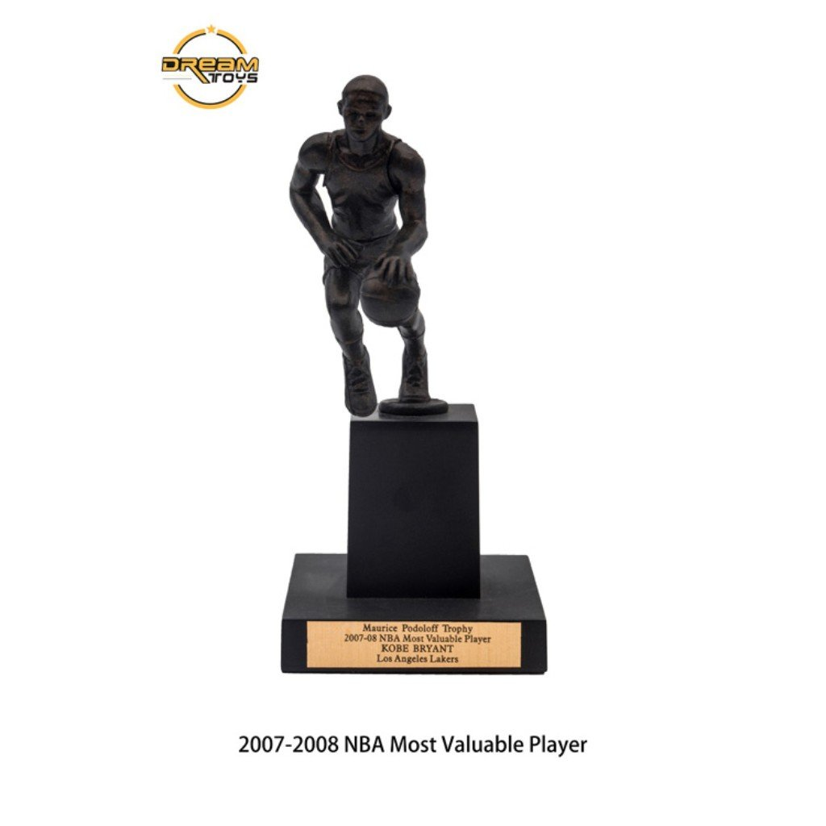
Definition – Most Valuable Player
Official Definition:
“Award given to the best performing player of the regular season”
Maurice Podoloff Trophy

Slide 3

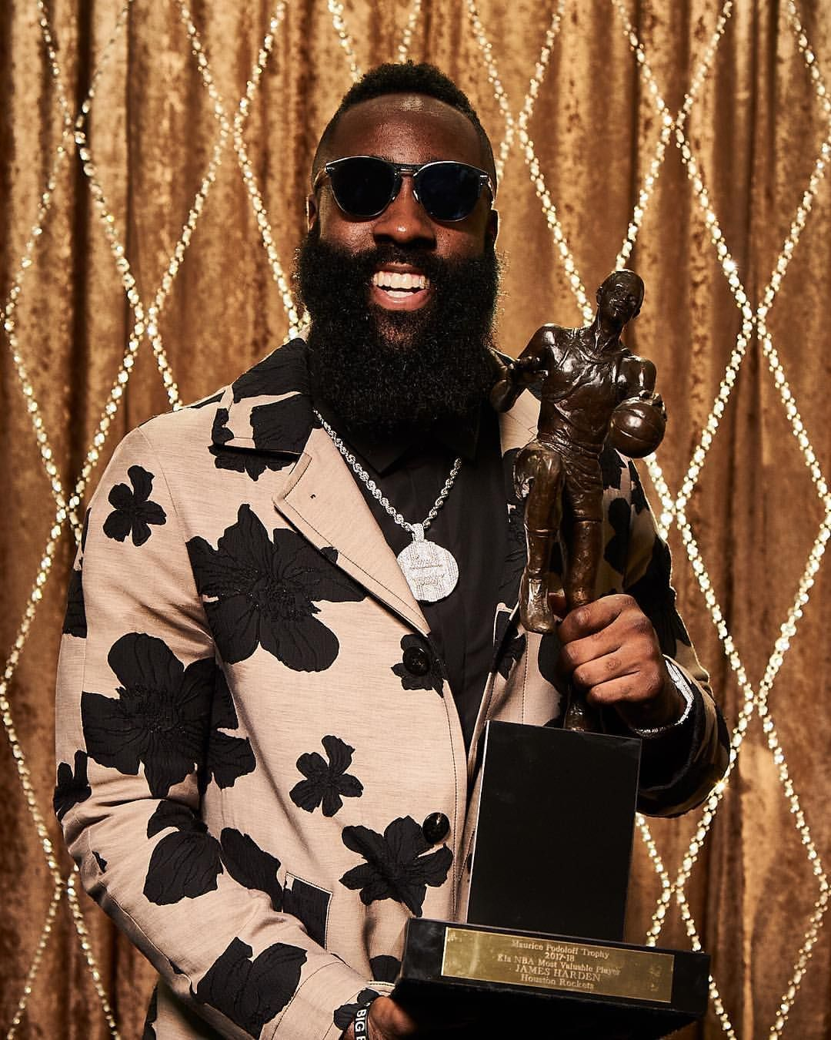








Deciding NBA’s MVP – The Process
10 points
7 points
Vote
5 points
Score
3 points
1 point
James Harden, 2018 NBA MVP

Slide 4

Deciding NBA’s MVP – Problems
Best performing player ??
LUL WHUT!?????
Nick Young AKA Swaggy P Perpetually confused

Slide 5

Deciding NBA’s MVP – Problems
The MVP is the best player on the best team with the best record.
Steve Aschburner
NBA.com

Slide 6
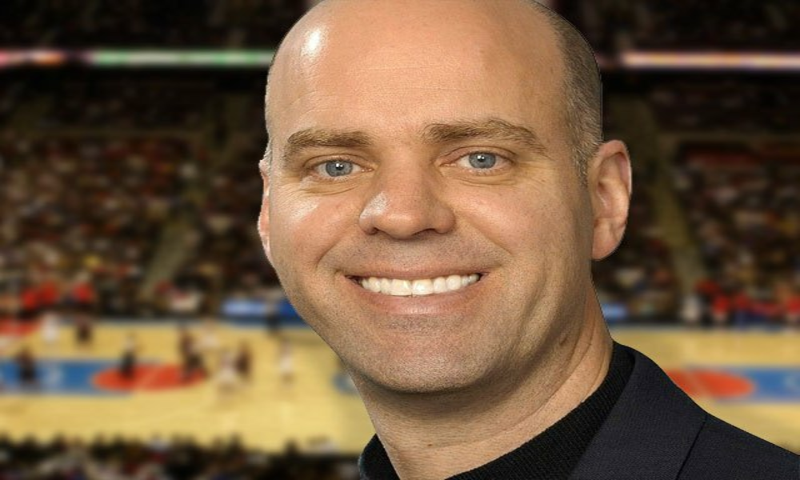
Deciding NBA’s MVP – Problems
The MVP is all about value: who has done the most for his team?
Ian Thomsen
Sports Illustrated

Slide 7
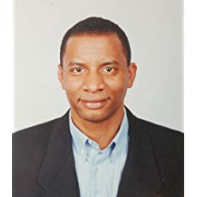
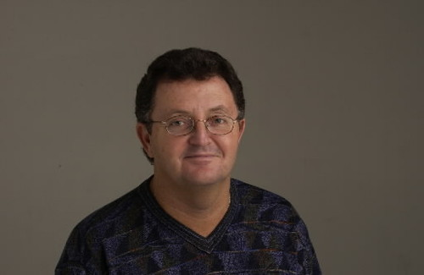
Deciding NBA’s MVP – Problems
The MVP is about doing what others have not done before.
Shaun Powell
NBA.com

Slide 8
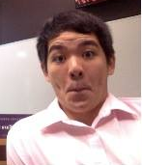
Problem Statement
Attempt to use statistics and machine learning modelling to bring objectivity to how the MVP award is decided
Leong Keng Whye
General Assembly
Notes:
My goal is to make this process more objective by using machine learning and statistics

Slide 9
Dataset
Kaggle + data from basketballreference.com
Kaggle: 17k rows (24k) x 51 columns
BballReference: Past MVP candidates & winners, Team Wins
Imbalanced dataset
406 MVP candidates out of 17148 players (2.36%)

Slide 10
Dataset
Features/Predictors:
WS, TS%, AST/G, VORP, PPG, PER, TRB/G, TOV/G, PF/G, BLK/G, ‘Impact’
Comparing statistical gaps between MVPs and non-MVPs
Correlation between MVP and statistic
Examining past winners of the award
Catering to narratives & tendencies of sports writers
Target
MVP column (1 if player is an MVP candidate, else 0)
Notes:
Impact – [(Team Wins * Games Played) / 82] * [(Minutes Played / 48) * (Usage % / 100)]
Measures how impactful player has been at contributing to the number of games his team has won
Averaged out by the number of games player played, minutes played in a game and how often he has been involved in the team’s offensive possession
TS% (True shooting percentage)
Captures 2P%, 3P%, FT%, FGA%, eFG%
Didn’t’ include those cause of multicollinearity
Since its inception, the award is mostly won by transcendent offensive players
- Examples: Stephen Curry, Lebron James, Michael Jordan, Kevin Durant, James Harden
- Exceptions: Kevin Garnett (All-around D, rebounder), Tim Duncan? (Stable scorer, paint camper, rebounder), Bill Russell (Beast rebounder)

Slide 11
Dataset
Notes:
Impact – [(Team Wins * Games Played) / 82] * [(Minutes Played / 48) * (Usage % / 100)]
Measures how impactful player has been at contributing to the number of games his team has won
Averaged out by the number of games player played, minutes played in a game and how often he has been involved in the team’s offensive possession
TS% (True shooting percentage)
Captures 2P%, 3P%, FT%, FGA%, eFG%
Didn’t’ include those cause of multicollinearity
Since its inception, the award is mostly won by transcendent offensive players
- Examples: Stephen Curry, Lebron James, Michael Jordan, Kevin Durant, James Harden
- Exceptions: Kevin Garnett (All-around D, rebounder), Tim Duncan? (Stable scorer, paint camper, rebounder), Bill Russell (Beast rebounder)

Slide 12
Dataset
Features/Predictors:
WS, TS%, AST/G, VORP, PPG, PER, TRB/G, TOV/G, PF/G, BLK/G, ‘Impact’
Correlation between MVP and statistic
Examining past winners of the award
Comparing statistical gaps between MVPs and non-MVPs
Catering to narratives & tendencies of sports writers
Target
MVP column (1 if player is an MVP candidate, else 0)
Notes:
Impact – [(Team Wins * Games Played) / 82] * [(Minutes Played / 48) * (Usage % / 100)]
Measures how impactful player has been at contributing to the number of games his team has won
Averaged out by the number of games player played, minutes played in a game and how often he has been involved in the team’s offensive possession
TS% (True shooting percentage)
Captures 2P%, 3P%, FT%, FGA%, eFG%
Didn’t’ include those cause of multicollinearity
Since its inception, the award is mostly won by transcendent offensive players
- Examples: Stephen Curry, Lebron James, Michael Jordan, Kevin Durant, James Harden
- Exceptions: Kevin Garnett (All-around D, rebounder), Tim Duncan? (Stable scorer, paint camper, rebounder), Bill Russell (Beast rebounder)

Slide 13
Methodology
SMOTE/ADASYN
Oversampling technique based on K-nearest-neighbours
Parameters to tune:
k_neighbors
sampling_strategy
Ensemble Models
Random Forest Classifier
Balanced/Bagging Classifier
base_estimator – Logistic Regression, XGBoost
n_estimators
sampling_strategy
max_samples
Synthetic Minority Over-sampling Technique (SMOTE)
Ensemble Models (Random Forest, Balanced Bagging Classifier)
Notes:
SMOTE parameters
k_neighbors = n, used to determine the number of nearest neighbours used to construct synthetic samples
Sampling_strategy = float, used to determine proportion of minority to majority
Balanced/Bagging Classifier parameters
base_estimator, chose Logistic Regression + XGBoost. LogReg didn’t perform well
n_estimators, the number of models to run
max_samples, the number of samples to draw to train from each model
sampling_strategy, the proportion between classes for each model

Slide 14
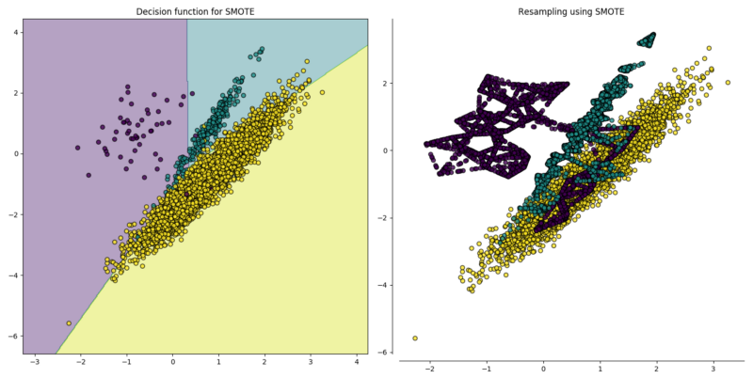
Methodology - SMOTE
Notes:
SMOTE parameters
k_neighbors = n, used to determine the number of nearest neighbours used to construct synthetic samples
Sampling_strategy = float, used to determine proportion of minority to majority

Slide 15
Methodology
SMOTE
Oversampling technique based on K-nearest-neighbours
Parameters to tune:
k_neighbors
sampling_strategy
Ensemble Models
Random Forest Classifier
Balanced/Bagging Classifier
base_estimator – Logistic Regression, XGBoost
n_estimators
sampling_strategy
Synthetic Minority Over-sampling Technique (SMOTE)
Ensemble Models (Random Forest, Balanced Bagging Classifier)
Notes:
SMOTE parameters
k_neighbors = n, used to determine the number of nearest neighbours used to construct synthetic samples
Sampling_strategy = float, used to determine proportion of minority to majority
Balanced/Bagging Classifier parameters
base_estimator, chose Logistic Regression + XGBoost. LogReg didn’t perform well
n_estimators, the number of models to run
max_features, the number of samples to draw to train from each model
sampling_strategy, the proportion between classes for each model

Slide 16
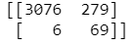
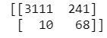
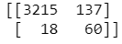
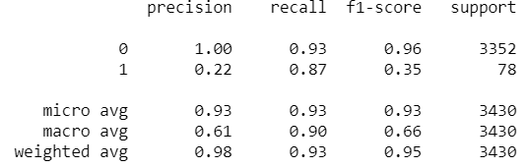
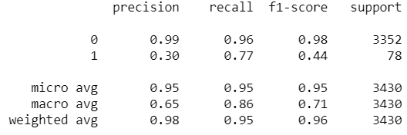
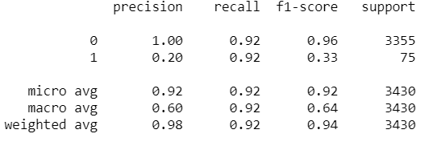
Results
XGBoost &
BBC
SMOTE & Logistic Regression
SMOTE & Random Forest
Notes:
Recall = TN/(TN + FP) [FP Bottom left]
Precision = TN/(TN + FN) [FN top right]
Coefficient Importance – TS%, WS, BLK/G, TOV/G
XGBoost – TRB/G, PPG, Impact, TS%, TOV/G, PF/G

Slide 17
Results: NBA 2018 MVP
Rank | Actual Rank | LogR + Smote | XGBoost + BBC | Rforest + SMOTE
1 | J. Harden | L. James | R. Westbrook | L. James
2 | L. James | J. Harden | L. James | D. Lillard
3 | A. Davis | R. Westbrook | K. Durant | V. Oladipo
4 | D. Lillard | A. Davis | J. Harden | K. Durant
5 | R. Westbrook | D. Lillard | Giannis A. | J. Harden
6 | Giannis A. | Giannis A. | D. Lillard | A. Davis
7 | K. Durant | K. Durant | V. Oladipo | D. Derozan
8 | D. Derozan | B. Simmons | Steph Curry | Giannis A.
9 | L. Aldridge | K.A. Towns | N. Jokic | L. Aldridge
10 | Jimmy B., Steph Curry | N. Jokic | D. Derozan | R. Westbrook
11 | J. Embiid | D.M. Cousins | K. Walker | Steph Curry
12 | V. Oladipo | Steph Curry | K.A. Towns | Jimmy B.
Accuracy of Model
LogR + Smote
- 8/12 correct
- 2/3 top 3
XGBoost + BBC
- 9/12 correct
- 1/3 top 3
RForest + Smote
- 12/12 correct
- 1/3 top 3
Notes:
Models are generally quite accurate at predicting who are the players who would be in MVP contention
However, it is not so good at predicting the order
Good to use this as a general gauge, then refine the ordering based on knowledge of narrative
Case in point:
James Harden rated highly based on narratives as his team finished with the best record in the West
Anthony Davis improved his team from 34 to 48 wins from prior season
Lebron James just has monster stats + he’s in a team with scrubby teammates

Slide 18
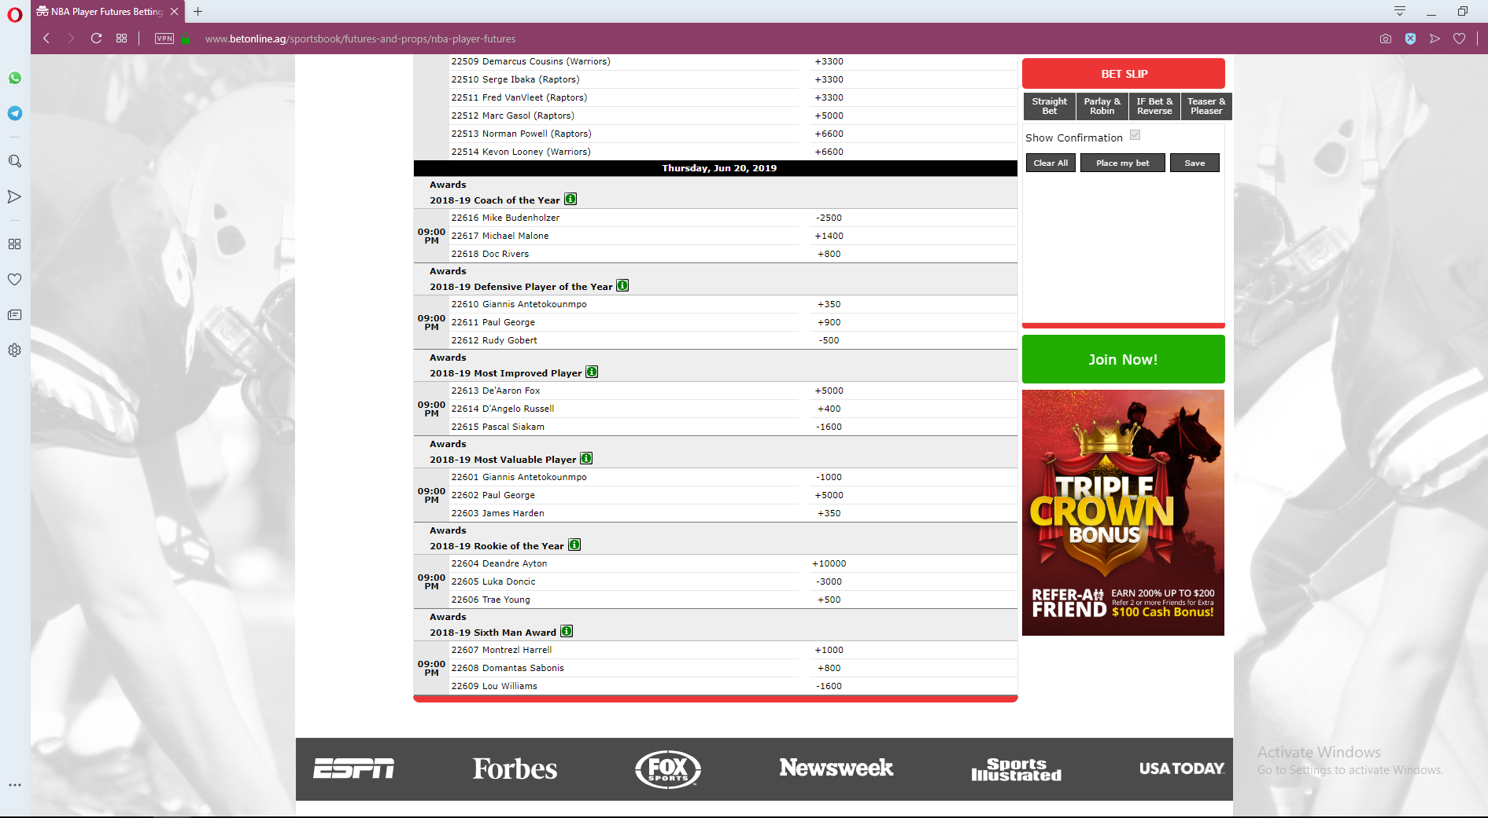
Use Case: BetOnline (2019 MVP)
BetOnline’s MVP odds
1. Giannis Antetokounmpo
2. James Harden
3. Paul George
Notes:
Recall = TN/(TN + FP) [FP Bottom left]
Precision = TN/(TN + FN) [FN top right]

Slide 19
Use Case: BetOnline (2019 MVP)
Rank | BetOnline | Bball-Ref | LogR + Smote | XGBoost + BBC | Rforest + SMOTE
1 | Giannis A. | Giannis A. | J. Harden | R. Westbrook | K. Durant
2 | J. Harden | J. Harden | Giannis A. | K. Durant | Steph Curry
3 | Paul George | N. Jokic | K. Durant | Giannis A. | D. Lillard
…
4 |  |  |  |  | Paul George
5
6 |  |  |  | James Harden
7 |  |  |  |  | J. Harden
8 |  |  |  |  | Giannis A.
9 |  | Paul George | Paul George
14 |  |  |  | Paul George
Notes:
Narratives:
Giannis great stats + team wins improvement from last season 44 – 60 wins
Paul George – Carried scoring load on lousy team, inconsistent in later half of season, likely to be captured by model

Slide 20
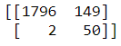
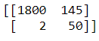
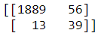
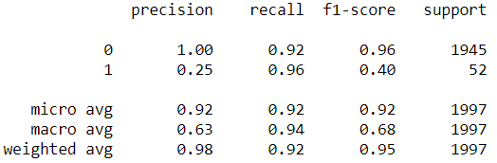
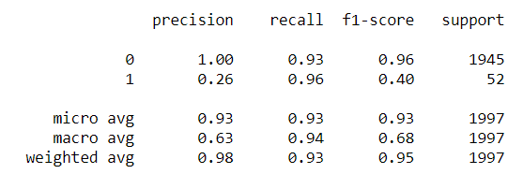
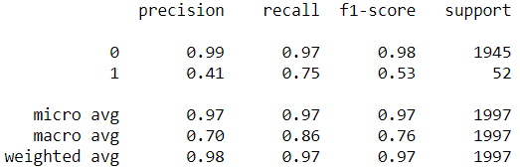
Results (with 1996+ data)
LogReg, ADASYN &
BaggingClassifier
Log Reg &
ADASYN
ADASYN & Random Forest
Notes:
Recall = TN/(TN + FP) [FP Bottom left]
Precision = TN/(TN + FN) [FN top right]
Coefficient Importance – TS%, WS, BLK/G, TOV/G
XGBoost – TRB/G, PPG, Impact, TS%, TOV/G, PF/G

Slide 21
Results: NBA 2018 MVP (with 1996+ data)
Rank | Actual Rank | LogR + ADASYN + BC | LogR + ADASYN
1 | J. Harden | J. Harden | L. James
2 | L. James | L. James | J. Harden
3 | A. Davis | R. Westbrook | R. Westbrook
4 | D. Lillard | A. Davis | A. Davis
5 | R. Westbrook | D. Lillard | D. Lillard
6 | Giannis A. | K. Durant | K. Durant
7 | K. Durant | Steph Curry | Giannis A.
8 | D. Derozan | Giannis A. | Steph Curry
9 | L. Aldridge | Chris Paul | N. Jokic
10 | Jimmy B., Steph Curry | N. Jokic | Jimmy B.
11 | J. Embiid | K. Irving | Chris Paul
12 | V. Oladipo | DeMarcus C. | K. Irving
Accuracy of Model
LogR + ADASYN + BC
- 8/12 correct
- 5/5 top 5
LogR + ADASYN
- 8/12 correct
- 5/5 top 3
Notes:
'BPM', 'TOV/G', 'PF/G', 'TS%', 'AST/G', 'VORP', 'BLK/G', 'PPG', 'TRB/G', 'Impact', 'PER'

Slide 22
Results: NBA 2019 MVP (with 1996+ data)
Rank | BetOnline | Bball-Ref | LogR + ADASYN + BC | LogR + ADASYN
1 | Giannis A. | Giannis A. | J. Harden | J. Harden
2 | J. Harden | J. Harden | Giannis A. | Giannis A.
3 | Paul George | N. Jokic | L. James | L. James
…
4
5
6
9 |  | Paul George
11 |  |  |  | Paul George
13 |  |  | Paul George
14
Notes:
Narratives:
Giannis great stats + team wins improvement from last season 44 – 60 wins
Paul George – Carried scoring load on lousy team, inconsistent in later half of season, likely to be captured by model

Slide 23
Limitations/Improvements
Playstyle changes over timespan of dataset
Conduct modelling on a smaller timespan with less variance in playstyle
Player intangibles difficult to capture via statistics
I.e. Gravity, hustle, leadership
Conduct more rigorous feature selection & feature engineering

Slide 24
Thank You
The Process is Completed
(For Now)

